Slide 1


Predicting the stock market with AI
by Daniel Stulberg Huf

Slide 2
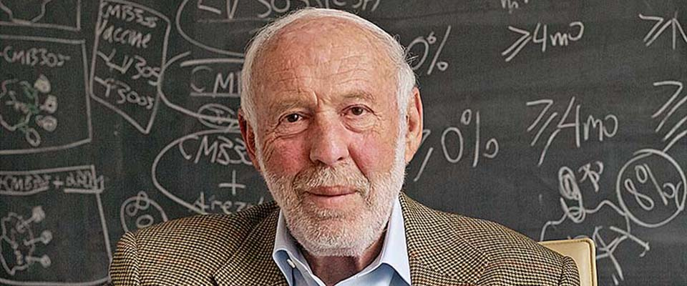


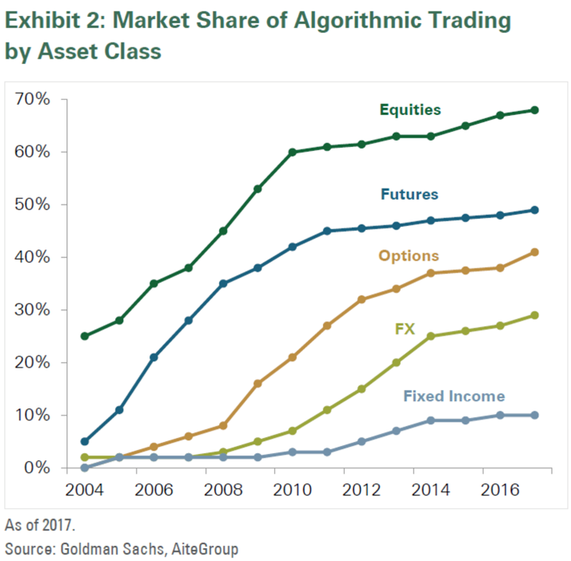
History of AI in finance
1970
1980
1982
1986
1990
2000
2003
2009
2018
2021
“AI winter”
FinCEN was using AI to identify potential money laundering
AI-driven ontology ranking of listed companies in the Taiwan stock market
Jim Simons founded Renaissance Technologies
Decisions on credit application started being done with AI
60-75 % of trading volume in the U.S. stock market is generated through algorithms
PlanPowerOne: first expert system that helped with financial plans
Renaissance Technologies market cap: $165B

Slide 3
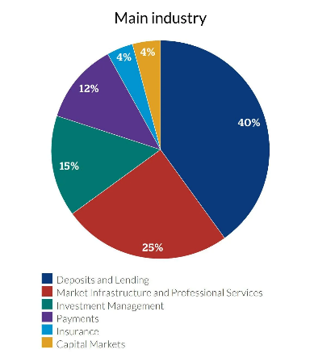
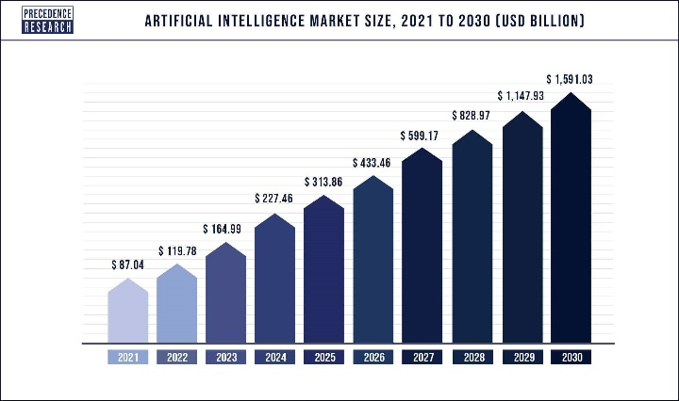
History of AI in finance
The 3 pillars of AI improvement:
Abundance of data
Computing power
Complex algorithms
Main areas in finance:
Credit scoring
Fraud detection
Quantitative trading
Cybersecurity protection
Predictive analysis

Slide 4
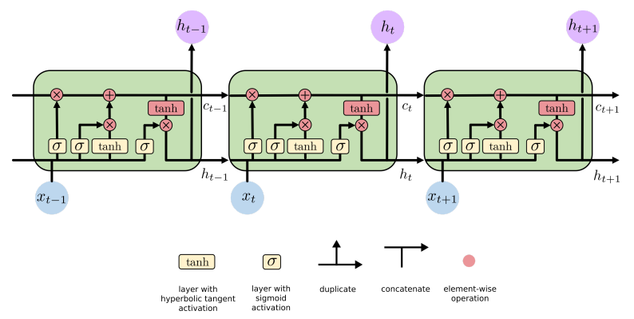
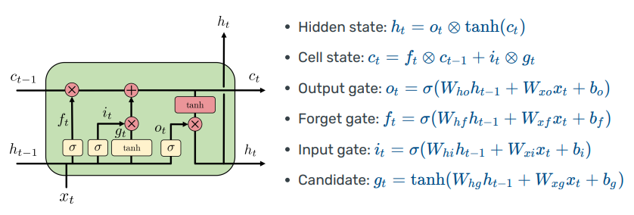
The LSTM network
the LSTM cell
Decides hidden states
Decides which bits are useful
Chooses new information to be added

Slide 5
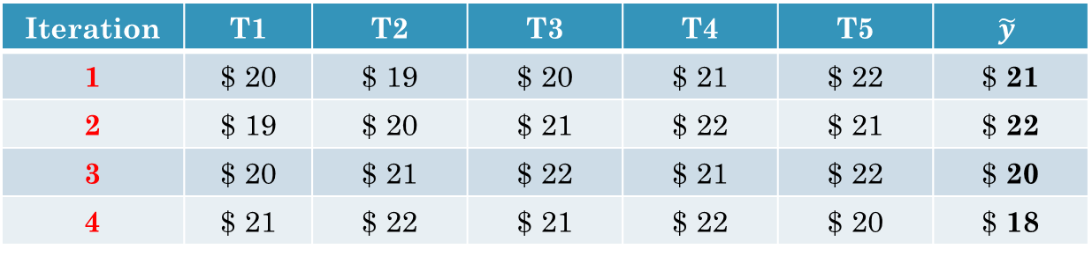
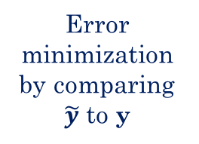
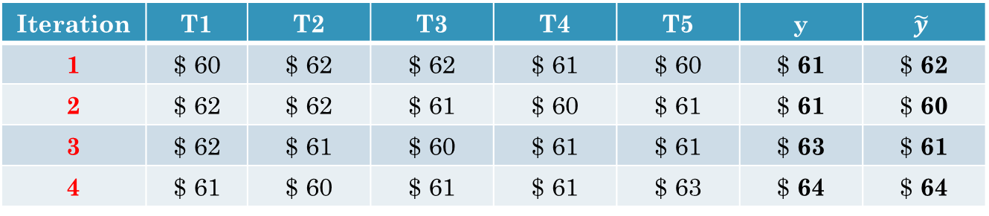
LSTM for stock price prediction
Training the model
Iteration | T1 | T2 | T3 | T4 | T5 | $$\tilde{y}$$
1 | $ 20 | $ 19 | $ 20 | $ 21 | $ 22 | $ 21
2 | $ 19 | $ 20 | $ 21 | $ 22 | $ 21 | $ 22
3 | $ 20 | $ 21 | $ 22 | $ 21 | $ 22 | $ 20
4 | $ 21 | $ 22 | $ 21 | $ 22 | $ 20 | $ 18
X_train
Y_train
(sequence to be trained)
(value generated by the model)
Testing the model
Iteration | T1 | T2 | T3 | T4 | T5 | y | $$\tilde{y}$$
1 | $ 60 | $ 62 | $ 62 | $ 61 | $ 60 | $ 61 | $ 62
2 | $ 62 | $ 62 | $ 61 | $ 60 | $ 61 | $ 61 | $ 60
3 | $ 62 | $ 61 | $ 60 | $ 61 | $ 61 | $ 63 | $ 61
4 | $ 61 | $ 60 | $ 61 | $ 61 | $ 63 | $ 64 | $ 64
Error minimization by comparing $\tilde{y}$ to y
X_test
Y_test
(real value to be compared)
(sequence to be tested)

Slide 6

LSTM: where it succeeds
Better at handling long-term dependencies due to their ability to remember information for extended time periods;
Less susceptible to the vanishing gradient problem;
Very efficient at modelling complex sequential data because they can learn high-level representations that capture the structure of the data.

Slide 7
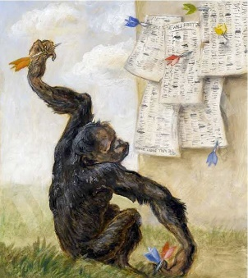
LSTM: where it fails
Requires more training data and takes more time to learn, compared to traditional RNNs;
Cannot remember prior information in a sequence with more than around 70 steps;
The stock market is far too complicated to model, and its behavior depends on various real world variables. An LSTM network can hardly process such behavior based solely on previous prices.
“ A blindfolded monkey throwing darts at a newspaper’s financial page could select a portfolio that would do just as well as one carefully selected by experts. ”
Burton Malkiel, Princeton economist, 1973

Slide 8
References
https://towardsdatascience.com/lstm-networks-a-detailed-explanation-8fae6aefc7f9
https://colah.github.io/posts/2015-08-Understanding-LSTMs/
https://analyzingalpha.com/history-of-ai-in-finance
https://www.datacamp.com/tutorial/lstm-python-stock-market
https://medium.com/analytics-vidhya/no-lstms-cant-predict-stock-prices-11f10dcb35d6
https://www.knowledgehut.com/blog/web-development/long-short-term-memory
Lecture held on 13/12 about Recurrent Neural Networks
Thank you!

